Slide 1

G5T7
Beh Wei Chen Goh Soo Chi Lim Jia Yu Shermin Tan Wong Wei Ling

Slide 2
CONTENTS
-01-
-02-
-03-
-04-
FUNCTIONALITIES
MILESTONES
SCHEDULE
BUG METRICS
-05-
-06-
PAIR PROGRAMMING TEAMS & ROTATIONAL PLANS
ROLES & RESPONSIBILITIES

Slide 3

FUNCTIONALITIES

Slide 4
FUNCTIONALITIES
FUNCTIONALITIES
No functionalities to be dropped/added at the moment
No PHP frameworks used
Completed login, bootstrap + 4.5 functionalities (Bid section, drop bid, drop section, start round & clear round 1)
IP address: 18.191.224.119
skulked4154]campsite
Admin password for cloud deployment:
Notes:
Highlight differences?

Slide 5

MILESTONES

Slide 6
MILESTONES
Iteration No. | Milestone | Date | PM In Charge
1 | PM Review | 3 Oct | Jia Yu
2 | Application Demo and Progress Update | 17 Oct | Wei Chen
3 | User Acceptance Test | 31 Oct | Shermin
4 | Final Submission | 17 Nov | Wei Ling
5 | Final Presentation | 21 Nov | Geralyn

Slide 7
SCHEDULES
SCHEDULES
ITERATION 1
ITERATION 2
ITERATION 3
ITERATION 4
ITERATION 5
Application Demo and Progress Update
User Acceptance Test
Final Submission
Final Presentation
PM Review

Slide 8
SCHEDULE FOR ITERATION 1 (2019/09/16 - 2019/10/03)
Task_ID | Task | Planned Start | Planned Finish | Buffer | Pair
1 | Plan project | 2019/09/16 | 2019/09/16 | - | All
2 | Create SQL scripts and DAOs | 2019/09/16 | 2019/09/16 | - | 1
3 | Create login.php and style.css | 2019/09/17 | 2019/09/17 | - | 2
4 | Complete DAOs and classes | 2019/09/19 | 2019/09/19 | 1 | 2
5 | Create Student & Admin index.php | 2019/09/21 | 2019/09/21 | 1 | 1
6_1 | Bootstrap student & course csv validation | 2019/09/22 | 2019/09/22 | - | 2

Slide 9
SCHEDULE FOR ITERATION 1 (2019/09/16 - 2019/10/03)
Task_ID | Task | Planned Start | Planned Finish | Buffer | Pair
6_2 | Bootstrap section & prerequisite csv validation | 2019/09/23 | 2019/09/23 | - | 1
6_3 | Bootstrap course_completed & bid csv validation | 2019/09/24 | 2019/09/24 | - | 2
7 | Combine bootstrap function | 2019/09/25 | 2019/09/25 | - | 1
8 | Amend protect.php to separate student and admin logins | 2019/09/28 | 2019/09/28 | 2 | 1
9 | Authenticate and bootstrap json checker | 2019/09/29 | 2019/09/29 | - | 2

Slide 10
SCHEDULE FOR ITERATION 1 (2019/09/16 - 2019/10/03)
Task_ID | Task | Planned Start | Planned Finish | Buffer | Pair
10 | Prepare test cases and run it for login and bootstrap | 2019/09/30 | 2019/09/30 | - | 1
11 | Finish up bootstrap test cases and prepare bug metrics | 2019/10/1 | 2019/10/1 | - | 1
12 | Deploy app | 2019/10/1 | 2019/10/1 | - | 2
13 | Prepare PM Review deliverables | 2019/10/2 | 2019/10/2 | - | All

Slide 11
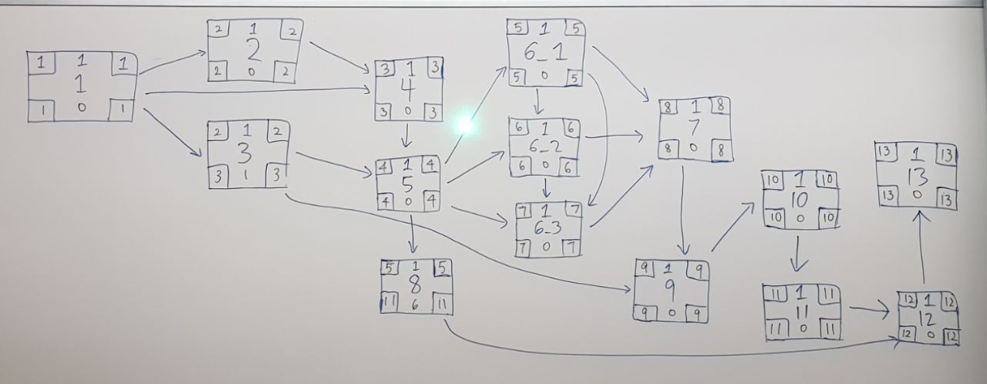
ITERATION 1
W O R K I N G S

Slide 12
CRITICAL PATH
ITERATION 1
6_1
1
2
4
5
6_2
7
9
6_3
10
11

Slide 13
SCHEDULES
SCHEDULES
ITERATION 1
ITERATION 2
ITERATION 3
ITERATION 4
ITERATION 5
Application Demo and Progress Update
User Acceptance Test
Final Submission
Final Presentation
PM Review

Slide 14
SCHEDULE FOR ITERATION 2 (2019/10/04 - 2019/10/16)
Task_ID | Task | Planned Start | Planned Finish | Buffer | Pair
1 | Plan for Iteration 2 functions, tasks and its allocation | 2019/10/04 | 2019/10/04 | - | All
2_1 | Place bid function (check active bidding round, invalid inputs, bidding round number & clash in class/exam timetables) | 2019/10/05 | 2019/10/05 | - | 2
2_2 | Place bid function (check prerequisite courses, sufficient e$, bids for same course) | 2019/10/06 | 2019/10/06 | - | 1
3 | Combine place bid function | 2019/10/06 | 2019/10/06 | - | 1
4 | Drop bid function | 2019/10/05 | 2019/10/05 | - | 1

Slide 15
SCHEDULE FOR ITERATION 2 (2019/10/04 - 2019/10/16)
Task_ID | Task | Planned Start | Planned Finish | Buffer | Pair
5 | Drop section function | 2019/10/06 | 2019/10/06 | - | 2
6_1 | bid section, drop bid json checker | 2019/10/09 | 2019/10/9 | 2 | 1
6_2 | drop section json checker | 2019/10/09 | 2019/10/09 | - | 2
7 | Prepare testcases | 2019/10/09 | 2019/10/09 | - | 1,2
8 | Complete testcases | 2019/10/12 | 2019/10/12 | 2 | All
9 | Run testcases for the 3 student functions + Regression Testing | 2019/10/12 | 2019/10/12 | - | Leader

Slide 16
SCHEDULE FOR ITERATION 2 (2019/10/04 - 2019/10/16)
Task_ID | Task | Planned Start | Planned Finish | Buffer | Pair
10 | Start round function (check bidding round and active bidding round) | 2019/10/12 | 2019/10/12 | - | 1
11 | Clear round function (round 1) | 2019/10/12 | 2019/10/12 | - | 2
12 | Debugging Session | 2019/10/13 | 2019/10/13 | - | 1
13 | Prepare bug metrics | 2019/10/14 | 2019/10/14 | - | Leader
14 | Deploy app | 2019/10/14 | 2019/10/14 | - | Leader
15 | Test app on web server and debugging, prepare bug metric | 2019/10/14 | 2019/10/14 | - | 3

Slide 17
SCHEDULE FOR ITERATION 2 (2019/10/04 - 2019/10/16)
Task_ID | Task | Planned Start | Planned Finish | Buffer | Pair
16 | Prepare app demo and progress update deliverables | 2019/10/16 | 2019/10/16 | 1 | All
17 | Application Demo and Progress Update | 2019/10/17 | 2019/10/17 | - | All
18 | PM Handover Meeting | 2019/10/17 | 2019/10/17 | - | PMs

Slide 18
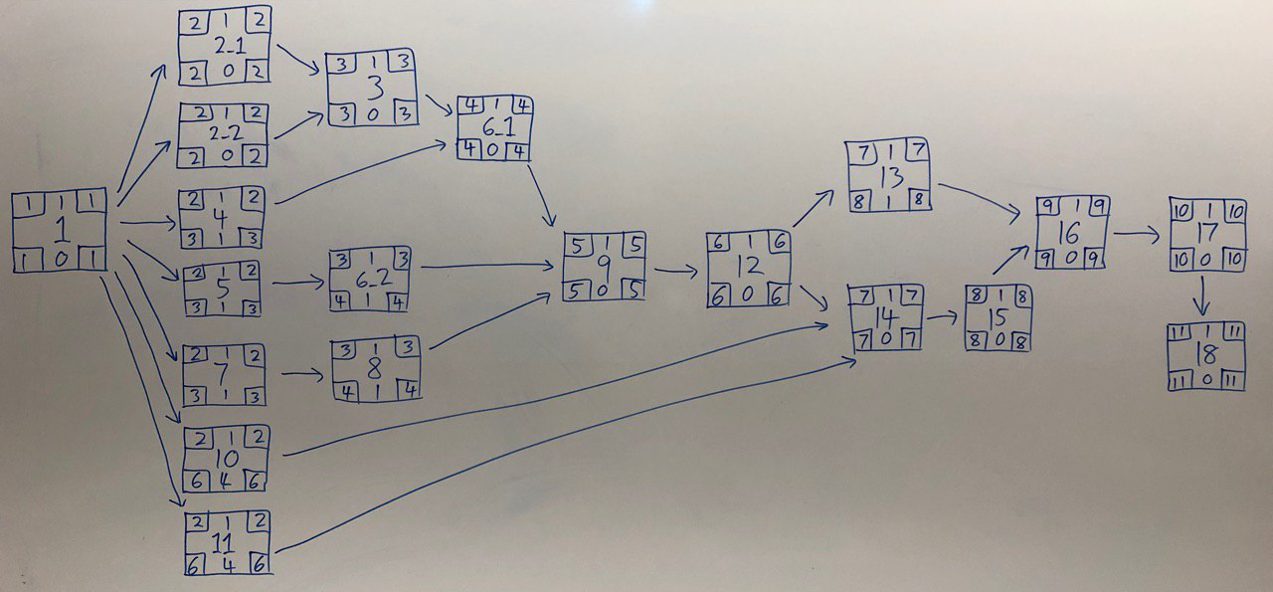
ITERATION 2
W O R K I N G S

Slide 19
CRITICAL PATH
ITERATION 2
6_1
2_1
3
9
12
16
17
1
2_2
14
15
18

Slide 20
SCHEDULES
SCHEDULES
ITERATION 1
ITERATION 2
ITERATION 3
ITERATION 4
ITERATION 5
Application Demo and Progress Update
User Acceptance Test
Final Submission
Final Presentation
PM Review

Slide 21
SCHEDULE FOR ITERATION 3 (2019/10/18 - 2019/10/31)
Task_ID | Task | Planned Start | Planned Finish | Buffer | Pair
1 | Plan for Iteration 3 tasks and its allocation | 2019/10/18 | 2019/10/18 | - | All
2 | Clear round function (round 2) | 2019/10/20 | 2019/10/20 | 1 | 1
3 | Combine clear round function | 2019/10/21 | 2019/10/21 | - | 1
4 | View bidding function | 2019/10/22 | 2019/10/22 | - | 2
5 | Start round, stop round json checker | 2019/10/24 | 2019/10/24 | 1 | 2
6 | Dump table, user, bid, section json checker | 2019/10/24 | 2019/10/24 | - | 1

Slide 22
SCHEDULE FOR ITERATION 3 (2019/10/18 - 2019/10/31)
Task_ID | Task | Planned Start | Planned Finish | Buffer | Pair
7 | Prepare test cases | 2019/10/26 | 2019/10/26 | 1 | 2
8 | Run test cases + regression testing | 2019/10/26 | 2019/10/26 | - | 2
9 | Debugging session | 2019/10/27 | 2019/10/27 | - | 1
10 | Prepare bug metrics | 2019/10/27 | 2019/10/27 | - | 2
11 | Deploy app | 2019/10/28 | 2019/10/28 | - | Leader
12 | Test app on web server + debugging, prepare bug metric | 2019/10/29 | 2019/10/29 | - | 1

Slide 23
SCHEDULE FOR ITERATION 3 (2019/10/18 - 2019/10/31)
Task_ID | Task | Planned Start | Planned Finish | Buffer | Pair
13 | Prepare for User Acceptance Test | 2019/10/30 | 2019/10/30 | - | All
14 | User Acceptance Test | 2019/10/31 | 2019/10/31 | 1 | All
15 | PM Handover Meeting | 2019/10/31 | 2019/10/31 | - | PMs

Slide 24
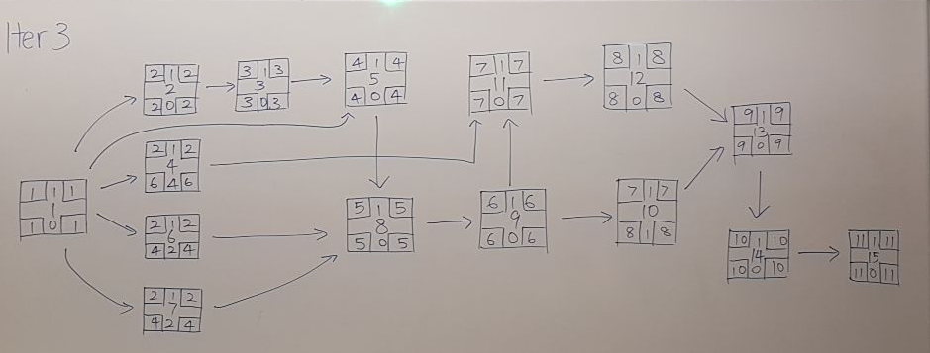
ITERATION 3
W O R K I N G S

Slide 25
CRITICAL PATH
ITERATION 3
2
3
5
11
12
13
1
8
9
14
15

Slide 26
SCHEDULES
SCHEDULES
ITERATION 1
ITERATION 2
ITERATION 3
ITERATION 4
ITERATION 5
Application Demo and Progress Update
User Acceptance Test
Final Submission
Final Presentation
PM Review

Slide 27
SCHEDULE FOR ITERATION 4 (2019/11/01 - 2019/11/17)
Task_ID | Task | Planned Start | Planned Finish | Buffer | Pair
1 | Plan for Iteration 4 tasks and its allocation | 2019/11/01 | 2019/11/01 | - | All
2 | Prepare additional test cases | 2019/11/02 | 2019/11/02 | - | 1
3 | Run test cases + regression testing | 2019/11/02 | 2019/11/02 | - | 1
4 | Fix all bugs from UAT and test cases | 2019/11/03 | 2019/11/03 | - | 2
5 | Prepare bug metrics | 2019/11/08 | 2019/11/08 | 4 | 1
6 | Deploy app | 2019/11/11 | 2019/11/11 | 2 | Leader

Slide 28
SCHEDULE FOR ITERATION 4 (2019/11/01 - 2019/11/17)
Task_ID | Task | Planned Start | Planned Finish | Buffer | Pair
7 | Test app on web server + debugging, prepare bug metric | 2019/11/12 | 2019/11/12 | - | 2
8 | Prepare for final submission | 2019/11/15 | 2019/11/15 | 2 | All
9 | Final Submission | 2019/11/17 | 2019/11/17 | 1 | Leader
10 | PM Handover Meeting | 2019/11/17 | 2019/11/17 | - | PMs

Slide 29
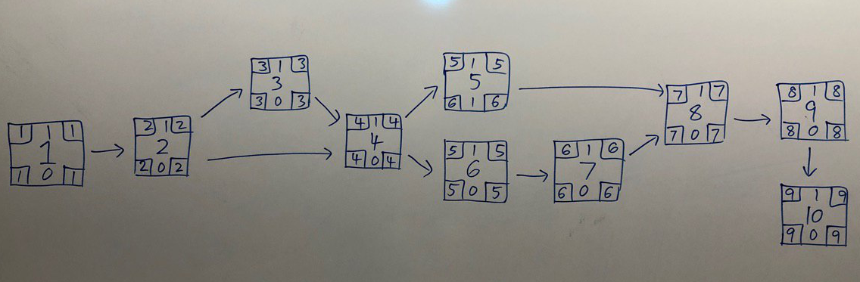
ITERATION 4
W O R K I N G S

Slide 30
CRITICAL PATH
ITERATION 4
3
1
2
4
6
7
8
9
10

Slide 31
SCHEDULES
SCHEDULES
ITERATION 1
ITERATION 2
ITERATION 3
ITERATION 4
ITERATION 5
Application Demo and Progress Update
User Acceptance Test
Final Submission
Final Presentation
PM Review

Slide 32
SCHEDULE FOR ITERATION 5 (2019/11/18 - 2019/11/21)
Task_ID | Task | Planned Start | Planned Finish | Buffer | Pair
1 | Plan for Iteration 5 tasks and its allocation | 2019/11/18 | 2019/11/18 | - | All
2 | Prepare for final presentation | 2019/11/19 | 2019/11/19 | - | All
3 | Final Presentation | 2019/11/21 | 2019/11/21 | 1 | All

Slide 33
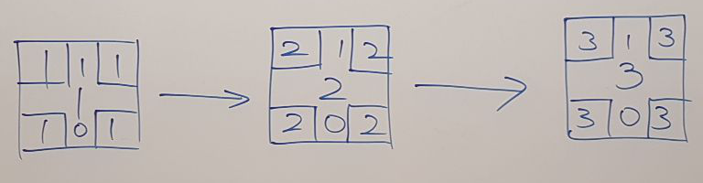
ITERATION 5
W O R K I N G S

Slide 34
CRITICAL PATH
ITERATION 5
1
2
3

Slide 35

BUG METRICS

Slide 36
BUG METRICS
BUG METRICS
S/N | Iteration | Function | Description | Severity | Points | Final Bug Metrics (Total Points) | Mitigation
1 | 1 | Bootstrap | Start round and clear round link placeholders missing from bootstrap page | Low | 1 | 7 | Use the planned debugging time in the iteration.
2 | 1 | Bootstrap | Failed to print correct number of bid.csv rows processed | High | 5
3 | 1 | Bootstrap | Course.php convertDateTime function var_dumps a bunch of datetime objects on json | Low | 1
Notes:
Write that this is from iter1?

Slide 37
BUG METRICS
BUG METRICS
S/N | Iteration | Function | Description | Severity | Points | Final Bug Metrics (Total Points) | Mitigation
4 | 2 | Authenticate | Error messages not in alphabetical order | Low | 1 | 46 | Stop current development and resolve the bug immediately. PM reschedules project.
5 | 2 | Bootstrap | Fatal error encountered: function name must be a string at line 10 | Critical | 10
6 | 2 | Bid Section | Bids below e$10 were accepted | High | 5
7 | 2 | Bid Section | Bids amount with more than 2 decimal places were accepted | High | 5
8 | 2 | Update Section | Admin able to bid during inactive round | High | 5

Slide 38
BUG METRICS
BUG METRICS
S/N | Iteration | Function | Description | Severity | Points | Final Bug Metrics (Total Points) | Mitigation
9 | 2 | Update Section | Error message should be 'section limit reached', not 'not own school course' | High | 5 | 46 | Stop current development and resolve the bug immediately. PM reschedules project.
10 | 2 | Delete Bid | Admin able to delete bid during inactive round | High | 5
11 | 2 | Drop Section | Admin unable to drop section despite valid inputs and active round | High | 5
12 | 2 | Drop Section | Error message should be 'round not active', not 'no such enrollment record' | High | 5

Slide 39
BUG LOG
BUG LOG
S/N | Iteration | Function | Description | Status | Discovered on | Resolved on | PP team
1 | 1 | Bootstrap | Start round and clear round link placeholders missing from bootstrap page | Resolved | 25/09/2019 | 25/09/2019 | BWC & TS
2 | 1 | Bootstrap | Failed to print correct number of bid.csv rows processed | Resolved | 25/09/2019 | 25/09/2019 | BWC & TS
3 | 1 | Bootstrap | Course.php convertDateTime function var_dumps a bunch of datetime objects on json | Resolved | 02/10/2019 | 02/10/2019 | BWC & TS
4 | 2 | Authenticate | Error messages not in alphabetical order | Resolved | 12/10/2019 | 13/10/2019 | TS & LJY
Notes:
Bug log: needs results column

Slide 40
BUG LOG
BUG LOG
S/N | Iteration | Function | Description | Status | Discovered on | Resolved on | PP team
5 | 2 | Bootstrap | Fatal error encountered: function name must be a string at line 10 | Resolved | 12/10/2019 | 13/10/2019 | TS & LJY
6 | 2 | Bid Section | Bids below e$10 were accepted | Resolved | 12/10/2019 | 13/10/2019 | TS & LJY
7 | 2 | Bid Section | Bids amount with more than 2 decimal places were accepted | Resolved | 12/10/2019 | 13/10/2019 | TS & LJY
8 | 2 | Update Bid | Admin able to bid during inactive round | Unresolved | 12/10/2019

Slide 41
BUG LOG
BUG LOG
S/N | Iteration | Function | Description | Status | Discovered on | Resolved on | PP team
9 | 2 | Update Bid | Error message should be 'section limit reached', not 'not own school course' | Unresolved | 12/10/2019
10 | 2 | Delete Bid | Admin able to delete bid during inactive round | Unresolved | 12/10/2019
11 | 2 | Drop Section | Admin unable to drop section despite valid inputs and active round | Unresolved | 12/10/2019
12 | 2 | Drop Section | Error message should be 'round not active', not 'no such enrollment record' | Unresolved | 12/10/2019

Slide 42

ROLES AND RESPONSIBILITIES

Slide 43
ROLES AND RESPONSIBILITIES
 | PM | Pair (1) | Pair (2) | Pair (3) | Dates | Milestones
Iteration 1 | Jia Yu | Wei Chen, Shermin | Geralyn, Wei Ling | - | 2019/09/16 - 2019/10/2 | PM Review
Iteration 2 | Wei Chen | Jia Yu, Shermin | Geralyn, Wei Ling | Wei Chen Geralyn | 2019/10/04 - 2019/10/16 | App Demo
Iteration 3 | Shermin | Wei Chen, Jia Yu | Geralyn, Wei Ling | - | 2019/10/18 - 2019/10/30 | UAT
Iteration 4 | Wei Ling | Wei Chen, Shermin | Geralyn, Jia Yu | - | 2019/11/01 - 2019/11/08 | Final Submission
Iteration 5 | Geralyn | Wei Chen, Wei Ling Jia Yu, Shermin |  |  | 2019/11/15 - 2019/11/21 | Final Presentation

Slide 44

PAIR PROGRAMMING TEAMS

Slide 45
PAIR PROGRAMMING TEAMS
 | Pair (1a) | Pair (1b) | Pair (2a) | Pair (2b) | PM
Iteration 1 | Wei Chen | Shermin | Geralyn | Wei Ling | Jia Yu
Iteration 2 | Jia Yu | Shermin | Geralyn | Wei Ling | Wei Chen
Iteration 3 | Wei Chen | Jia Yu | Geralyn | Wei Ling | Shermin
Iteration 4 | Shermin | Wei Chen | Geralyn | Jia Yu | Wei Ling
Iteration 5 | Wei Ling Wei Chen Shermin Jia Yu |  |  |  | Geralyn

Slide 46
THANK YOU

